Slide 1
HIGH FREQUENCY TRADING STRATEGIES

Slide 2
MARKET MICROSTRUCTURE/ TERMINOLOGY

Slide 3
Market Order vs Limit Order
Market Order – Buy/Sell order to be executed immediately at current market prices.
Limit Order – An order to buy/sell at a specific price or better. (PRICE and TIME PRIORITY)

Slide 4
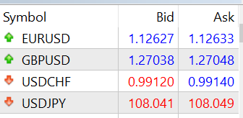
HIT THE BID/ASK
Hit/Lift the Bid - Market SELL Order
Hit/Lift the Ask – Market BUY Order

Slide 5
Level I Market Data
Bid Price – Highest posted price somebody is willing to buy an asset at
Bid Size – Number of shares/contracts people are queuing to buy at bid price.
Ask Price – Lowest posted price somebody is willing to sell an asset at
Ask Size - Number of shares/contracts people are queuing to sell at ask price.

Slide 6
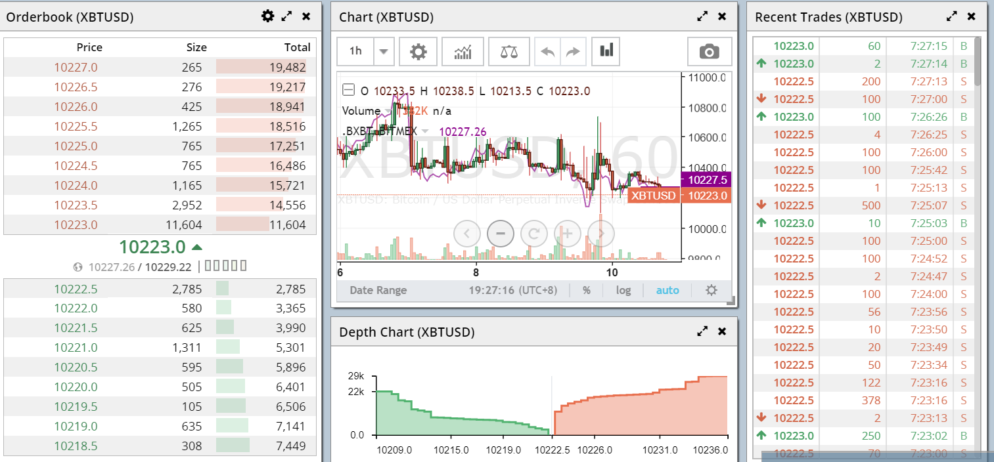
Level II Market Data

Slide 7
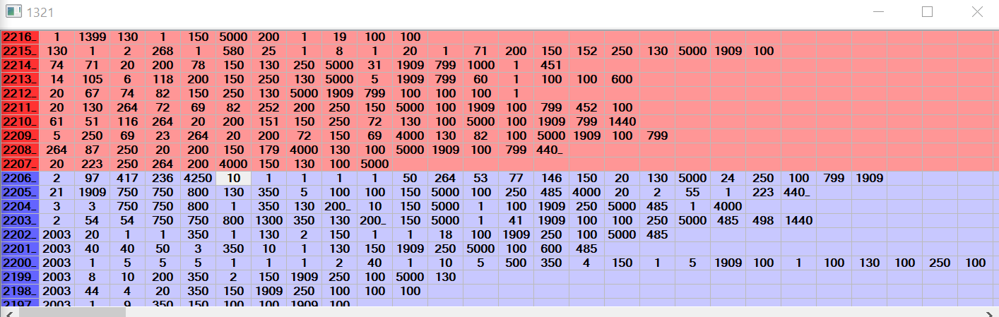
Level III Market Data
Insert, Modify and Delete Orders

Slide 8
Spot and Derivatives Definition
Spot Price – Current market price an asset can be bought/sold for immediate payment and delivery
Derivatives – A contract that derives it prices based on the performance of its underlying assets.
Stock Index – A measurement of a section of a stock market computed from the price of the selected stock based on a certain composition.

Slide 9
Example of Derivatives
Futures – A financial contract which obliged buyers to purchase and seller to sell an asset at a predetermined future date and price. Can be cash settled or physical delivery.
Exchange Traded Funds (ETFs) – An Investment fund traded on a stock exchange much like a stock.
Options – A financial contract that give buyer/seller the rights to buy/sell an asset at a specified price and date.

Slide 10
Arbitrage Strategies

Slide 11
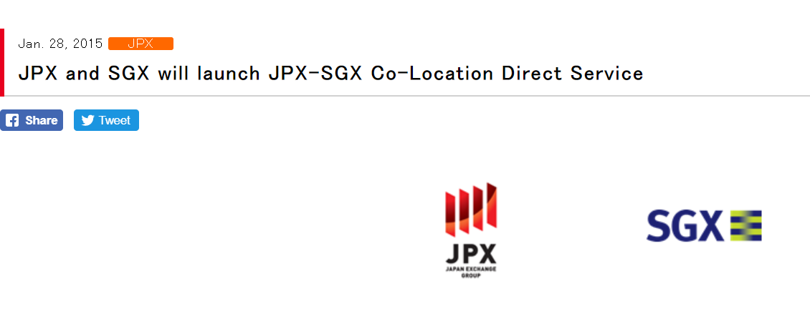
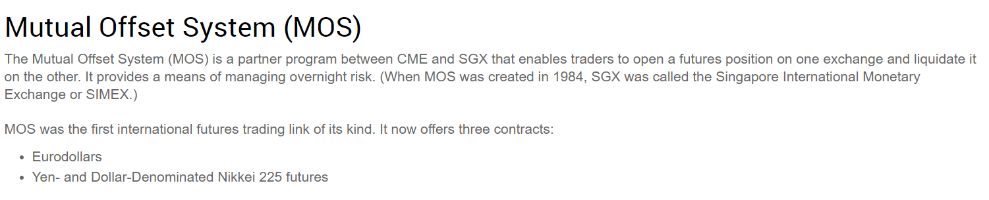
Arbitrage Between Exchanges

Slide 12
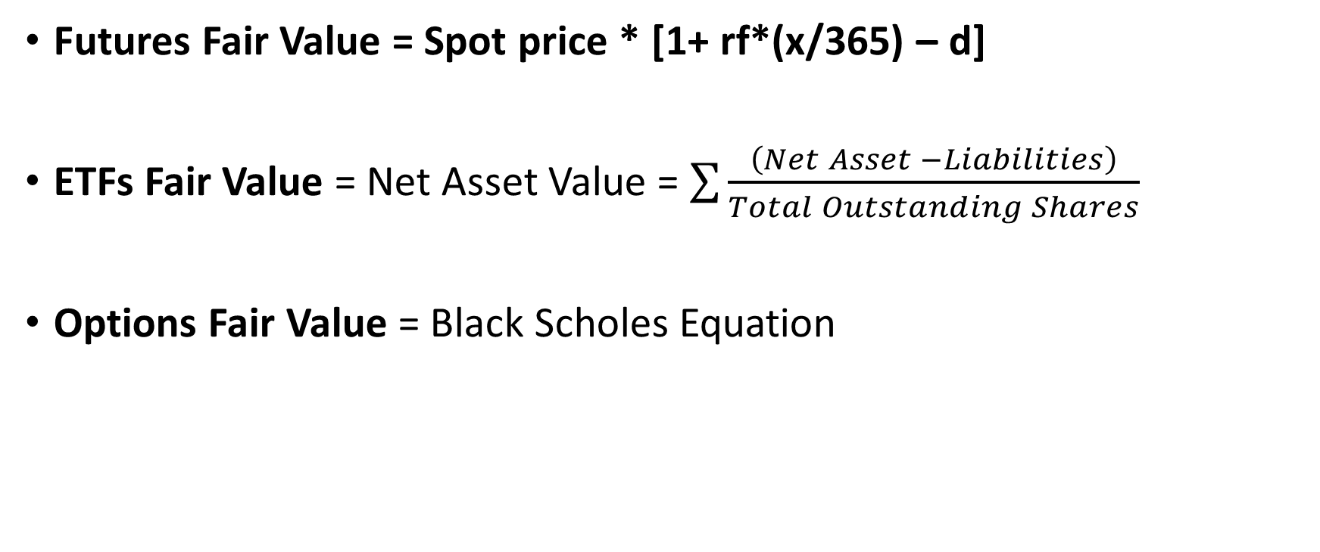
Spot-Derivatives Arbitrage
Futures Fair Value = Spot price * [1+ rf*(x/365) – d]
ETFs Fair Value = Net Asset Value = $\sum{\frac{\left(Net Asset −Liabilities\right)}{Total Outstanding Shares}}$
Options Fair Value = Black Scholes Equation

Slide 13
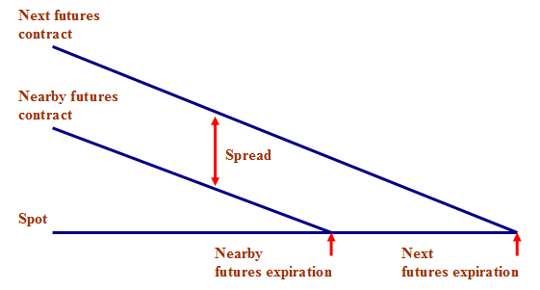
Calendar Spread Arbitrage
Futures Fair Value = Spot price * [1+ rf*(x/365) – d]

Slide 14
Arbitrage Between Banks/Brokers and Exchange
Banks and brokers may approach HFTs if they have clients getting out of huge positions. (A few thousands lots of futures etc).
Usually, they will give the HFTs a slightly better price than the exchange.

Slide 15
Pair Trading
Arbitrage between assets with huge correlation and cointegration.
At times, the correlation may be slightly off based on historical prices.
Examples are Bitcoin and Ethereum, Nikkei and Topix futures.

Slide 16
Risk Involve in Arbitraging
Too slow, arbitrage opportunities occur for at most milliseconds or even microseconds! Will be heading to nanoseconds in the future.
Exchange Regulation and futures settlement process.
Margin Requirement (Not enough funds in 1 particular exchange).

Slide 17
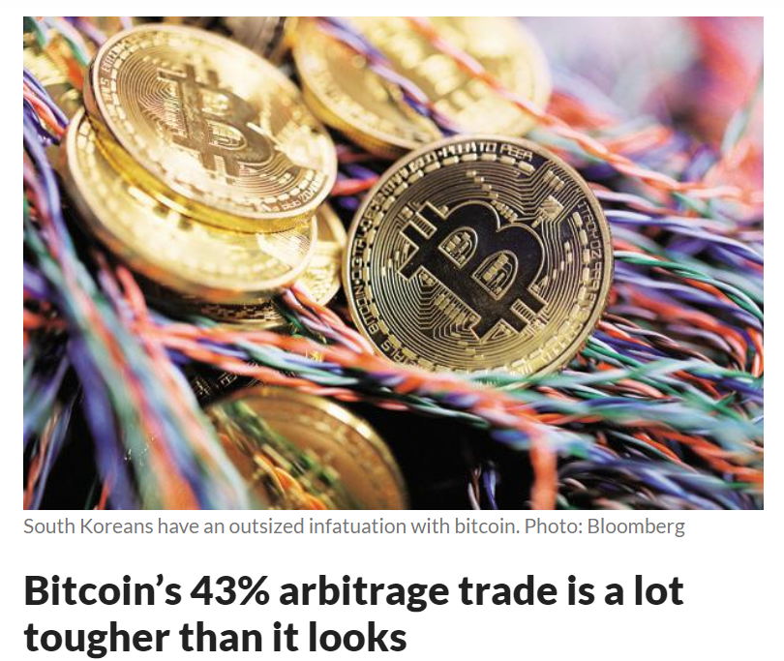

Slide 18
Market Making Strategies

Slide 19
Market Making
Involves quoting on both bid and ask side hoping to make profit from bid-offer spread or rebates from exchange (Bitmex pays market maker 2.5 basis points of commission fee for every trade).
Market Making of futures involves hedging on another month to maintain delta neutral.
Queue spot on the order book is very important, hence HFTs invest heavily on technology to compete against each other

Slide 20
Market Making
In the event that the market spikes in either direction, it spells problem for market makers
Quote further away from BBO when an economic data is expected to be released
Pull away orders when market spikes
Hit the bid (Market Sell) if there are bid orders at lower ticks if market spikes down and vice versa

Slide 21
Market Making
Quantitative models to predict the price in next few mins or seconds to place their orders.
Some traders rely on TA to quote their prices such as OHLC, support resistance etc.

Slide 22
Auction

Slide 23
What is Auction?
A process where buyers and sellers submit their price and volume order within a 5 minute interval.
During the auction, no trade is occurring until the auction ends
The price is determined by the Itayose (板寄) method which maximises traded volume and minimises untraded volume based on price-time priority.
Used to determine opening and closing prices as well as opening price after a circuit breaker/limit down.

Slide 24
How HFTs profit from Auctions?
Nikkei Futures quoted on SGX and JPX will always or almost always be at the same price due to arbitraging.
However, both exchanges close at different timing.
When JPX is closing, SGX is still open for trading.
Hence, traders will try to predict the direction or price which JPX Auction will close at and trade on SGX accordingly.

Slide 25
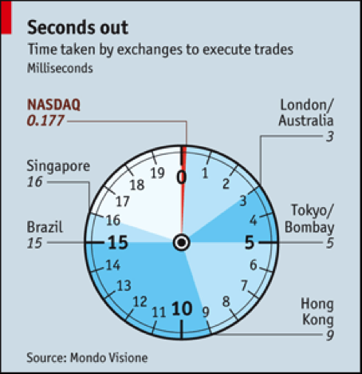

Slide 26
Technology Used by HFTs
Co-location in Exchanges
C++ Development, efficiency of code
Field Programmable Gate Array (FPGA)
Microwave Networks (https://gizmodo.com/how-high-speed-traders-use-microwaves-to-make-money-486353476)

Slide 27
Q & A

